Slide 1

z/OS DevOps Architectures
Nelson Lopez
Z DevOps Transformation Specialist
Nelson.lopez1@ibm.com

Slide 2
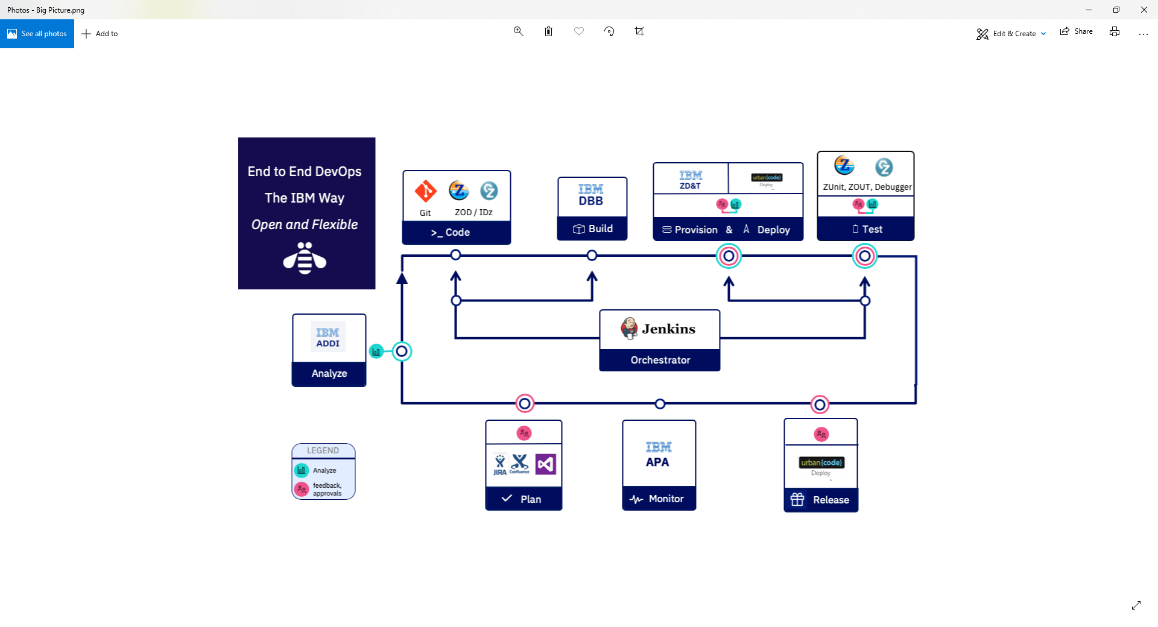
CI Phase

Slide 3






Example z/OS DevOps flow
Analysis & Planning
Development Phase
Continuous Deployment
Developer
Sprints
User Builds
Ops
. Automated Impact Analysis
. Code Checkout & packaging
. Automated Test environment buildout
Branch
Code
Commit
IDz
zUnit
Report
Build
QA …
PROD
Master
Git
Clones
Dev Repo
Pull Requests
zD&T
DBB
zUnit
Git Server
Orchestrator
Deployment Server
Modern cross platform/distributed SCM, with audit trails and history
Features
Continuous Integration
Team Build
Team
Repo
Admin
Lead
SIT
Report
Build`
Code Review
Approve
Merge
Modern Impact Discovery & Analysis with IBM “ADDI” & “DBB”. Automated environment buildout with IBM’s zD&T
Agile workflows supporting parallel and isolated developer sprints as well as integrated team builds
Stage
Deploy
Artifacts
Repo
DBB
zD&T
zUnit
Continuous Delivery
CI - Continuously Integrate new features with automated build, test and reporting. Use zD&T to provision an isolated test environment per developer/team.
(CD) Automated Delivery and Deploy, with versioning and fallback features

Slide 4





DBB Sample Architecture
Jenkins
Azure
Bamboo
Team City…
DBB WebApp
Dependency Metadata
Build Results History
3- Start
Pipeline
Orchestrator
z/OS
DB
Any Git Server
DBB Java Toolkit
2- Pull Request
Master Repository
Agent
CLONE to Z
MVS Java API’s
PDS
Local
repo
Groovy Build scripts
Compile
&
link
Scan, impact analysis, copy to PDS, compile, create artifacts, & report
1- Push
Run Groovy build script
Return status and Logs
Local Repo
USS
MVS
Desktop IDz
Notes:
FYI – IBM Offers Elite Support for Rocket Git for zOS (part # D226Qll) contact your sales rep for details

Slide 5


DBB pulls in all dependencies between programs and their copybooks for a build
Copybook1
PGM-A
Copybook2
PGM-B
Copybook3
PGM-C
Static Link
“Only build what you changed”

Slide 6
Getting to Git
Migrate Source to Git
Copy PDS members to a new Git REPO
DBB ScanOnly
Initialize DBB’s meta data for the application repo (aka Collection)
DBB
Impact-build
Define pipeline Job(s) for impact build
Notes:
How do you setup a pipeline to perform an Impact build?
In three steps …

Slide 7
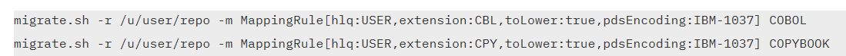
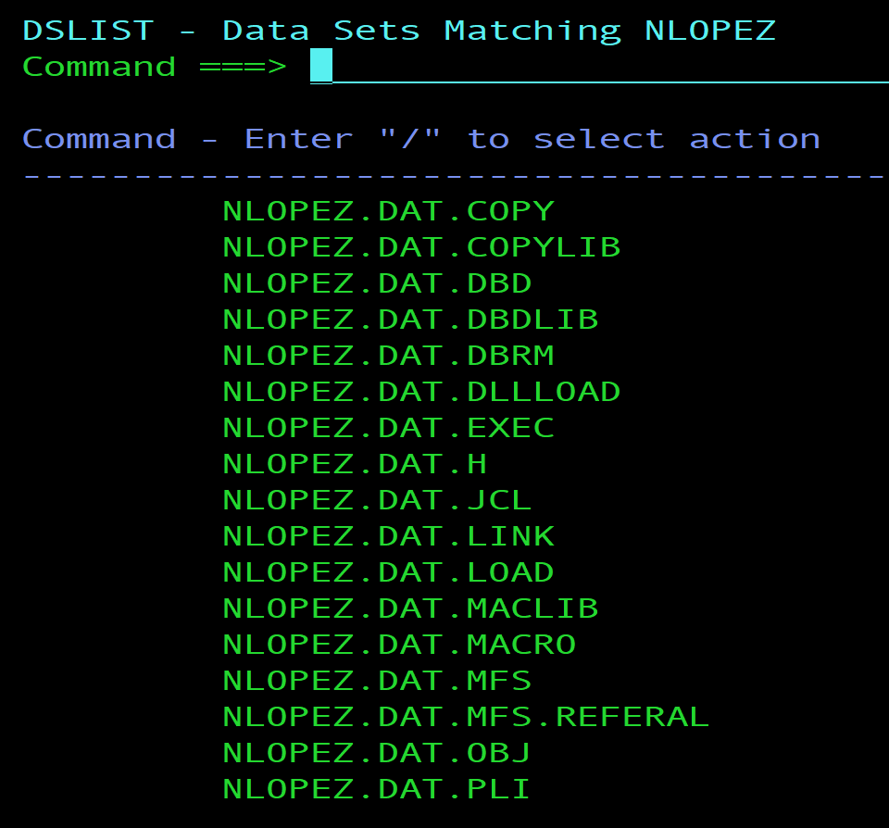
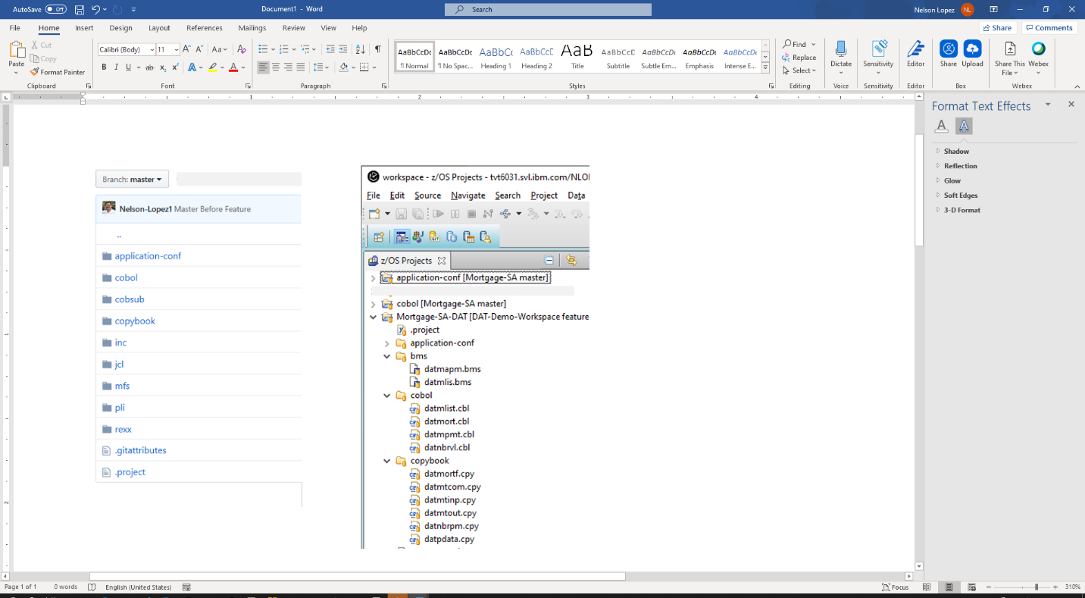
Step 1- Initialize a new Repo - DBB Migrate Tool
REF: https://www.ibm.com/support/knowledgecenter/SS6T76_1.0.8/migration.html
Migrate PDS to Git
Notes:
This is an example of how to migrate a PDS source library to Git
The DBB Toolkit provide a migrate utility (more on that in Day 3)

Slide 8
DBB’s Impact mode builds program(s) that have changed since the last successful build or initial state
Initial State
Impact
build
Impact
build
Impact
build
REPO
pgm-a
pgm-b
pgm-c
pgm-d
…
pgm-x
pgm-a
pgm-b
pgm-d
pgm-x
commit
commit
commit
Notes:
Impact build is a way of building only what has changed since the last successful build.
The diagram show a sample Repo with several pgms
And a timeline marking the commit points of various changes.
And the execution of an Impact build to process just the changes within a commit.

Slide 9

DBB/UCD – Build, Package, Release, Deploy
GIT
Urban Code Deploy
DBB
Build.groovy
Build
UCD Code Station
Component Versions
BuildReport.json
TARFILE
TARFILE
DBB
deploy.groovy
Package
TARFILE
TARFILE
Deploy
artifacts
TARFILE
TARFILE
artifacts
myapp.tar
artifacts
Load1, dbrm…
Shiplist.xml
BuzTool
Release
$LPAR=xyz
CICS – COPY LOAD
BATCH/CICS – COPY LOAD
DB2 BIND DBRM
NEWCOPY …
Continuous Integration
Continuous Deployment

Slide 10

DBB/Artifactory - Build, Package, Release, Deploy
GIT
DBB
Build.groovy
$LPAR=xyz
CICS – COPY LOAD
BATCH/NCAL – COPY LOAD
DB2 BIND DBRM
NEWCOPY
TARFILE
TARFILE
BuildReport.json
TARFILE
Package.groovy
TARFILE
TARFILE
artifacts
TARFILE
TARFILE
Artifacts
Publish.groovy
Pull.groovy
release
App.yaml
TARFILE
CicsDeployUtilities.groovy
Deploy
Application-conf/
deploy.$lpar.yaml

Slide 11
Big Picture
TagV1.0.0
TAG V2.0.0
Master
Git
Release
Dev (integration Branch)
Feature
Tools
IDz
Orchestrator
DBB/Groovy (build)
Release/Deploy Tool (UCD)
User Build
Unit Test
Team Build (CI)
Integration Test
Regression test
Functional test
Pen Test …
Runtime
User
Team
QA
Prod
Dev
QA
PROD

Slide 12




From CI to CD
GIT – Branching Model
Pipeline
CI
CD
M
M+1
Merge/rebase - Master
Prod M+1
Sprint
R+1
Release – Final Build
QA/UAT
R+1
D
PR – Integration Build
Team
F
F
User Feature build
User
F
BUILD
DEPLOY
RUN
M=Master, D=Develop, F=Feature, R=Release, +1 is a new tag version, Long Lived Branch

Slide 13
DevOps transformation journey with IBM’s DevOps Acceleration Program https://developer.ibm.com/mainframe/products/devops-acceleration-program/
Training
Adoption
Discovery and Design Workshop
SCM Migration
CI/CD
DevOps adoption
Assessment
Deployment
Maximize the value of transformation efforts
Know our DevOps Products and strategy
Instructor Led remote and Self Paced trainings
Install and customize products
Cloud entry point
emphasis to-date
Value Stream Assessment
Innovate
Adoption
Training
Deployment
Build new
cloud native applications
Delivered through
DevOps Acceleration Team
DAT - SCM Migration, CI/CD, DevOps adoption
Executed by IBM’s Sales SWAT team
Onsite Workshop to capture current state and create a transformation roadmap
ILT Virtual or Self paced trainings
Delivered through Deployment Project Office DPO - Remote assistance for upto 52 hours to install products
This is IBM’s Initiative to partner with you and accelerate the transformation
Notes:
Value Stream Assessment – Executed by SWAT team, offering DevOps VSA Engagement, CI/CD Pipeline Mapping, POV Presentations
Training – Covering Idz, ADDI and CI/CD, it is delivering through Z DevOps Learning team as both instructor led Virtual training and online Self paced training
Deployment – Delivered through Deployment project office , offers upto 52 hours of remote assistance to help deploy IDz and ADDI as per best practices
Adoption – Delivered through DevOps Acceleration Team, the team will start with capturing your current state and based on requirements design your future state. Help with preparing scripts and deploy the future state solution and CI/CD workflow.

